Slide 1
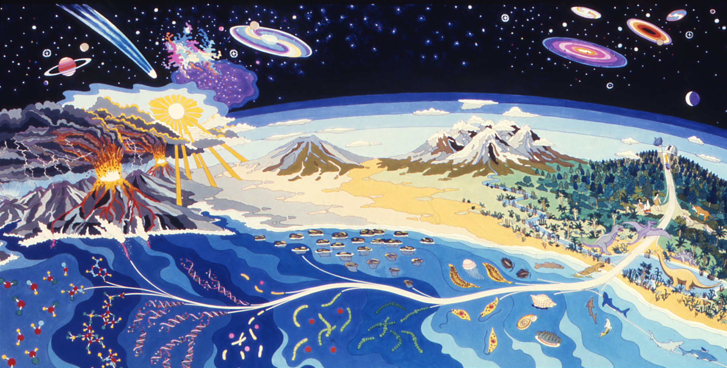
rna world and protoCELLS
Bio522S
2023-02-15

Slide 2
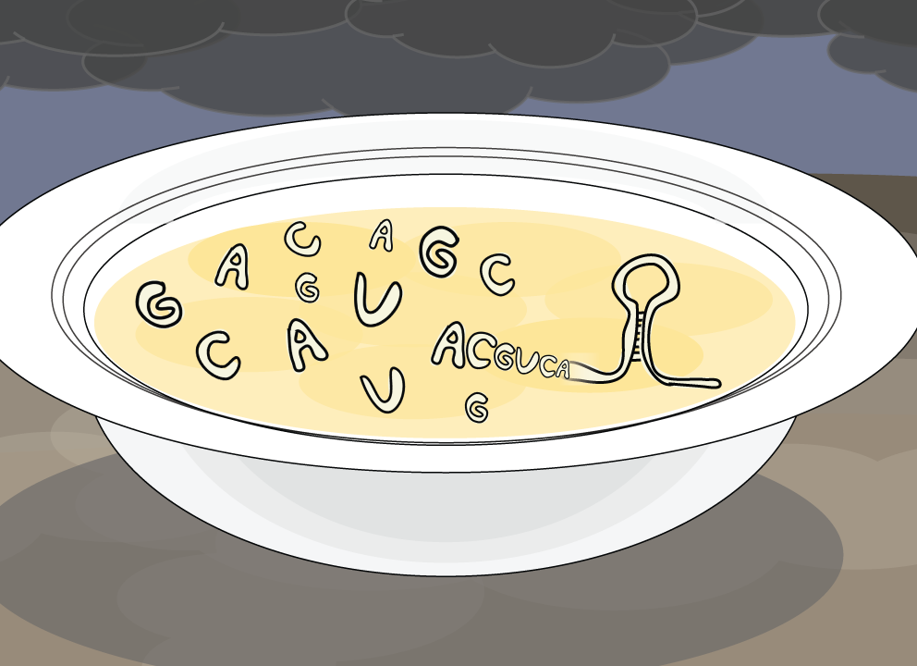
Metabolism first
RNA world
The origin of life

Slide 3
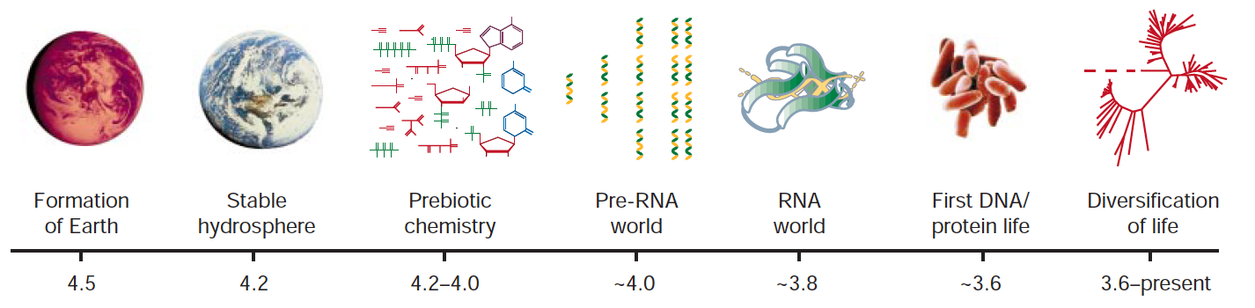
WHAT IS RNA WORLD
Self-replication
RNA
A
B
RNA
Catalysis
Joyce, Gerald F. "The antiquity of RNA-based evolution." nature 418.6894 (2002): 214.

Slide 4
RNA as THE fIRST GENETIC MATERIAL
Earth’s environment
Many available building blocks might exist, e.g. amino acids, hydroxy acids, sugars, purines,pyrimidines and fatty acids
Natural environment was subject to fluctuation
Fate of polymers
Self-replication
Polymerization
Monomer
Polymer
Degradation

Slide 5
RNA as THE fIRST GENETIC MATERIAL
RNA can encode compact information
through residual sequence
Information
RNA molecules replicate in the same manner regardless of its sequence
RNA can form various secondary structures, which can be simple and highly tolerant to sequence variation or entirely different due to critical mutations
Genetic
material
Stability
Subject to Darwinian evolution
Self-splicing introns allow recombination of exons, therefore produce new genes
Mutation

Slide 6
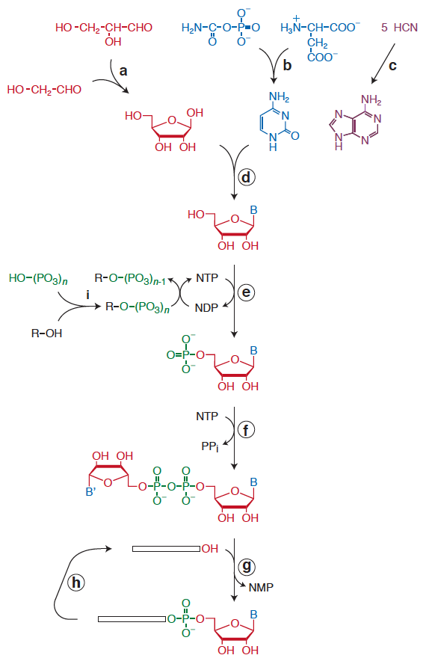
RNA as cATALYst
RNA catalyzed RNA polymerization
template-directed polymerization of activated mononucleotides
Many RNA can catalyzes NTP polymerization(e.g. class I ribozyme ligase RNA)
RNA catalyzed metabolism
Convert high energy starting materials to lower energy products
Ribozymes that catalyse some of the steps of nucleotide synthesis have been obtained by in vitro evolution
Metabolic pathways today may be remnants of RNA-based metabolism
RNA might catalyze peptide formation
Hypothetical pathway for RNA-catalysed synthesis of RNA.

Slide 7
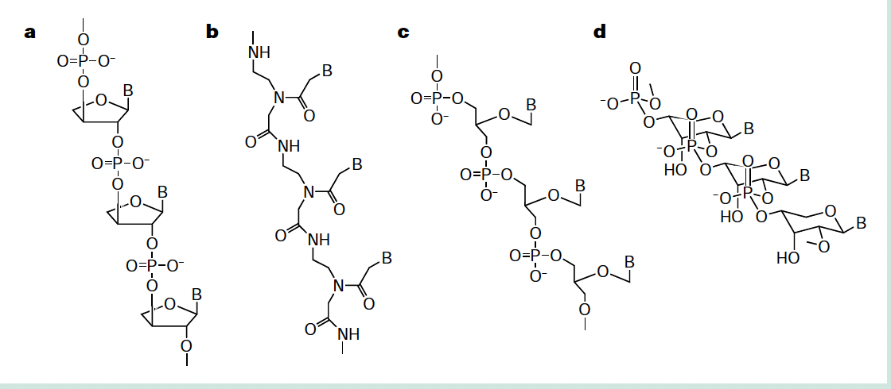
rna predecessor
Potential predecessors to RNA : PNA, TNA, certain peptides, clay
Their catalytic activities are yet to be discovered, along with how they facilitate the the appearance of RNA
TNA
PNA
Glycerol-derived
Pyranosyl-RNA

Slide 8
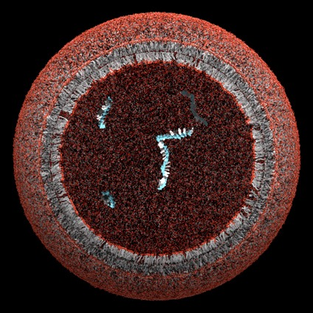
protocells
Simple chemical and physical processes
membrane + genetic material (e.g. RNA replicases)

Slide 9
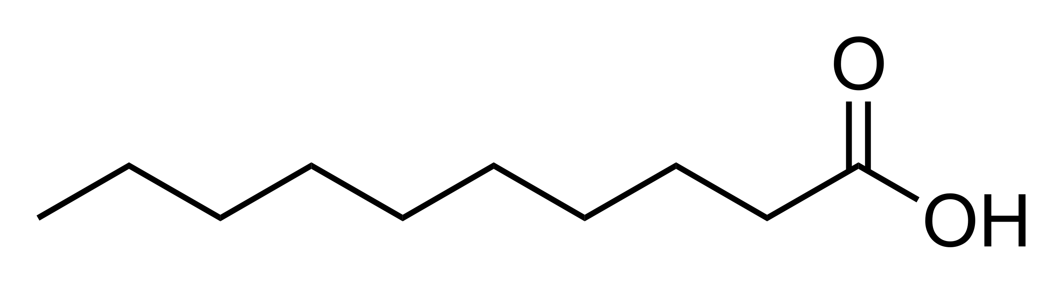
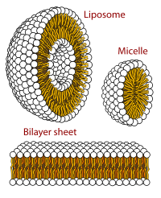
Formation of protocells
Self-replicating molecules that can copy more efficiently will be selected for
Fatty acids as membrane component
Capric acid
Fatty acid structure depends upon PH and temperature
PH ~ 8.5
PH>10
At low PH, they are protonated and become oil droplets

Slide 10
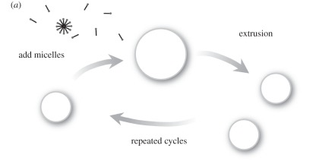
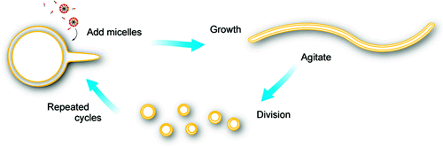
protocell formation, growth and division
Formation
Early earth provided moderate conditions for protocell formation
Extraterrestrial organic compounds brought to Earth in the Murchison meteorite could form membranous vesicles
Growth
Add micelles
Faster genomic replication leads to faster membrane growth (osmotic pressure change)
Division
Pass the vesicles through small pores
Multilamellar vesicles transform to thread-like vesicles under gentle perturbation, then divide into smaller vesicles
Zhu, Ting F., and Jack W. Szostak. 2009

Slide 11
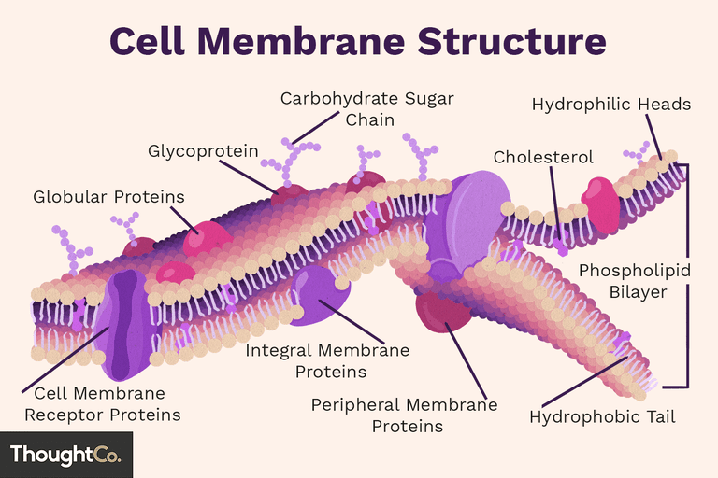
from primitive to modern membranes
Modern membrane
Phospholipids
Highly evolved biomachineries
The transition happened in several steps
Phospholipid promotes association of fatty acids and their dissociation

Slide 12
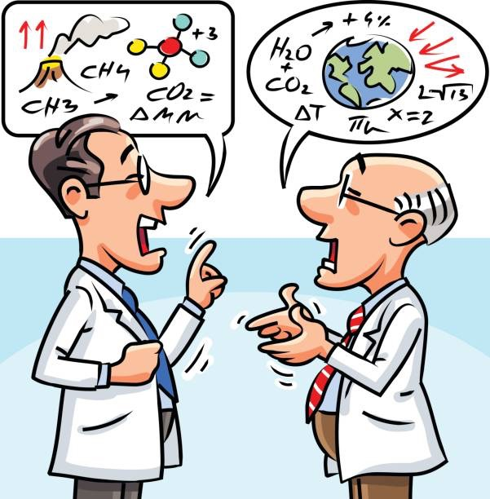
Team TED talks
Theme 1: Clarification and additional information on RNA world mechanisms published in the literature
Theme 2: Alternative theories within and beyond the RNA world
Use visual aids (a couple of slides or white board drawings)
Weave 2-3 themes together chosen from the lists on the wiki
Each team member participates in the talk (taking turns speaking, drawing on white board, etc).
Format
5 people per team
Now - 5:00 pm
Research and discussion

